Slide 1

November 17, 2015
3:30-4:30 pm ET
The Network for Regional Healthcare Improvement (NRHI) High-Value Care Support and Alignment Network (SAN) for the Transforming Clinical Practice Initiative (TCPI)
NRHI SAN Learning Event Kick-Off

Slide 2

An Introduction to SAN by Elizabeth Mitchell
https://vimeo.com/145353711

Slide 3
NRHI’s High-Value Care SAN
AGENDA
Welcome
Who is NRHI
What is TCPI
Who are the SANs and what is the NRHI High-Value Care SAN
NRHI SAN Clinical and Quality Experts:
  Better Health Partnership - Northeast Ohio
  Minnesota Community Measurement
  Institute for Clinical Systems Improvement
  Pittsburgh Regional Health Initiative
  Maine Quality Counts
  Massachusetts Health Quality Partners
  Oregon Healthcare Quality Corporation
How to get involved and learn more
Notes:
Stacy 335
You’ll learn a bit about NRHI and meet our staff, learn more about the areas of focus of our High-Value Care SAN, and have the opportunity to hear from 5 of our clinical and quality expert faculty

Slide 4
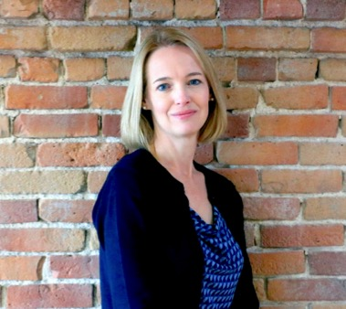
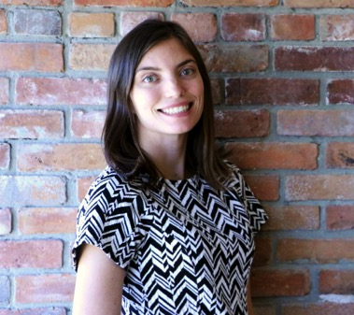
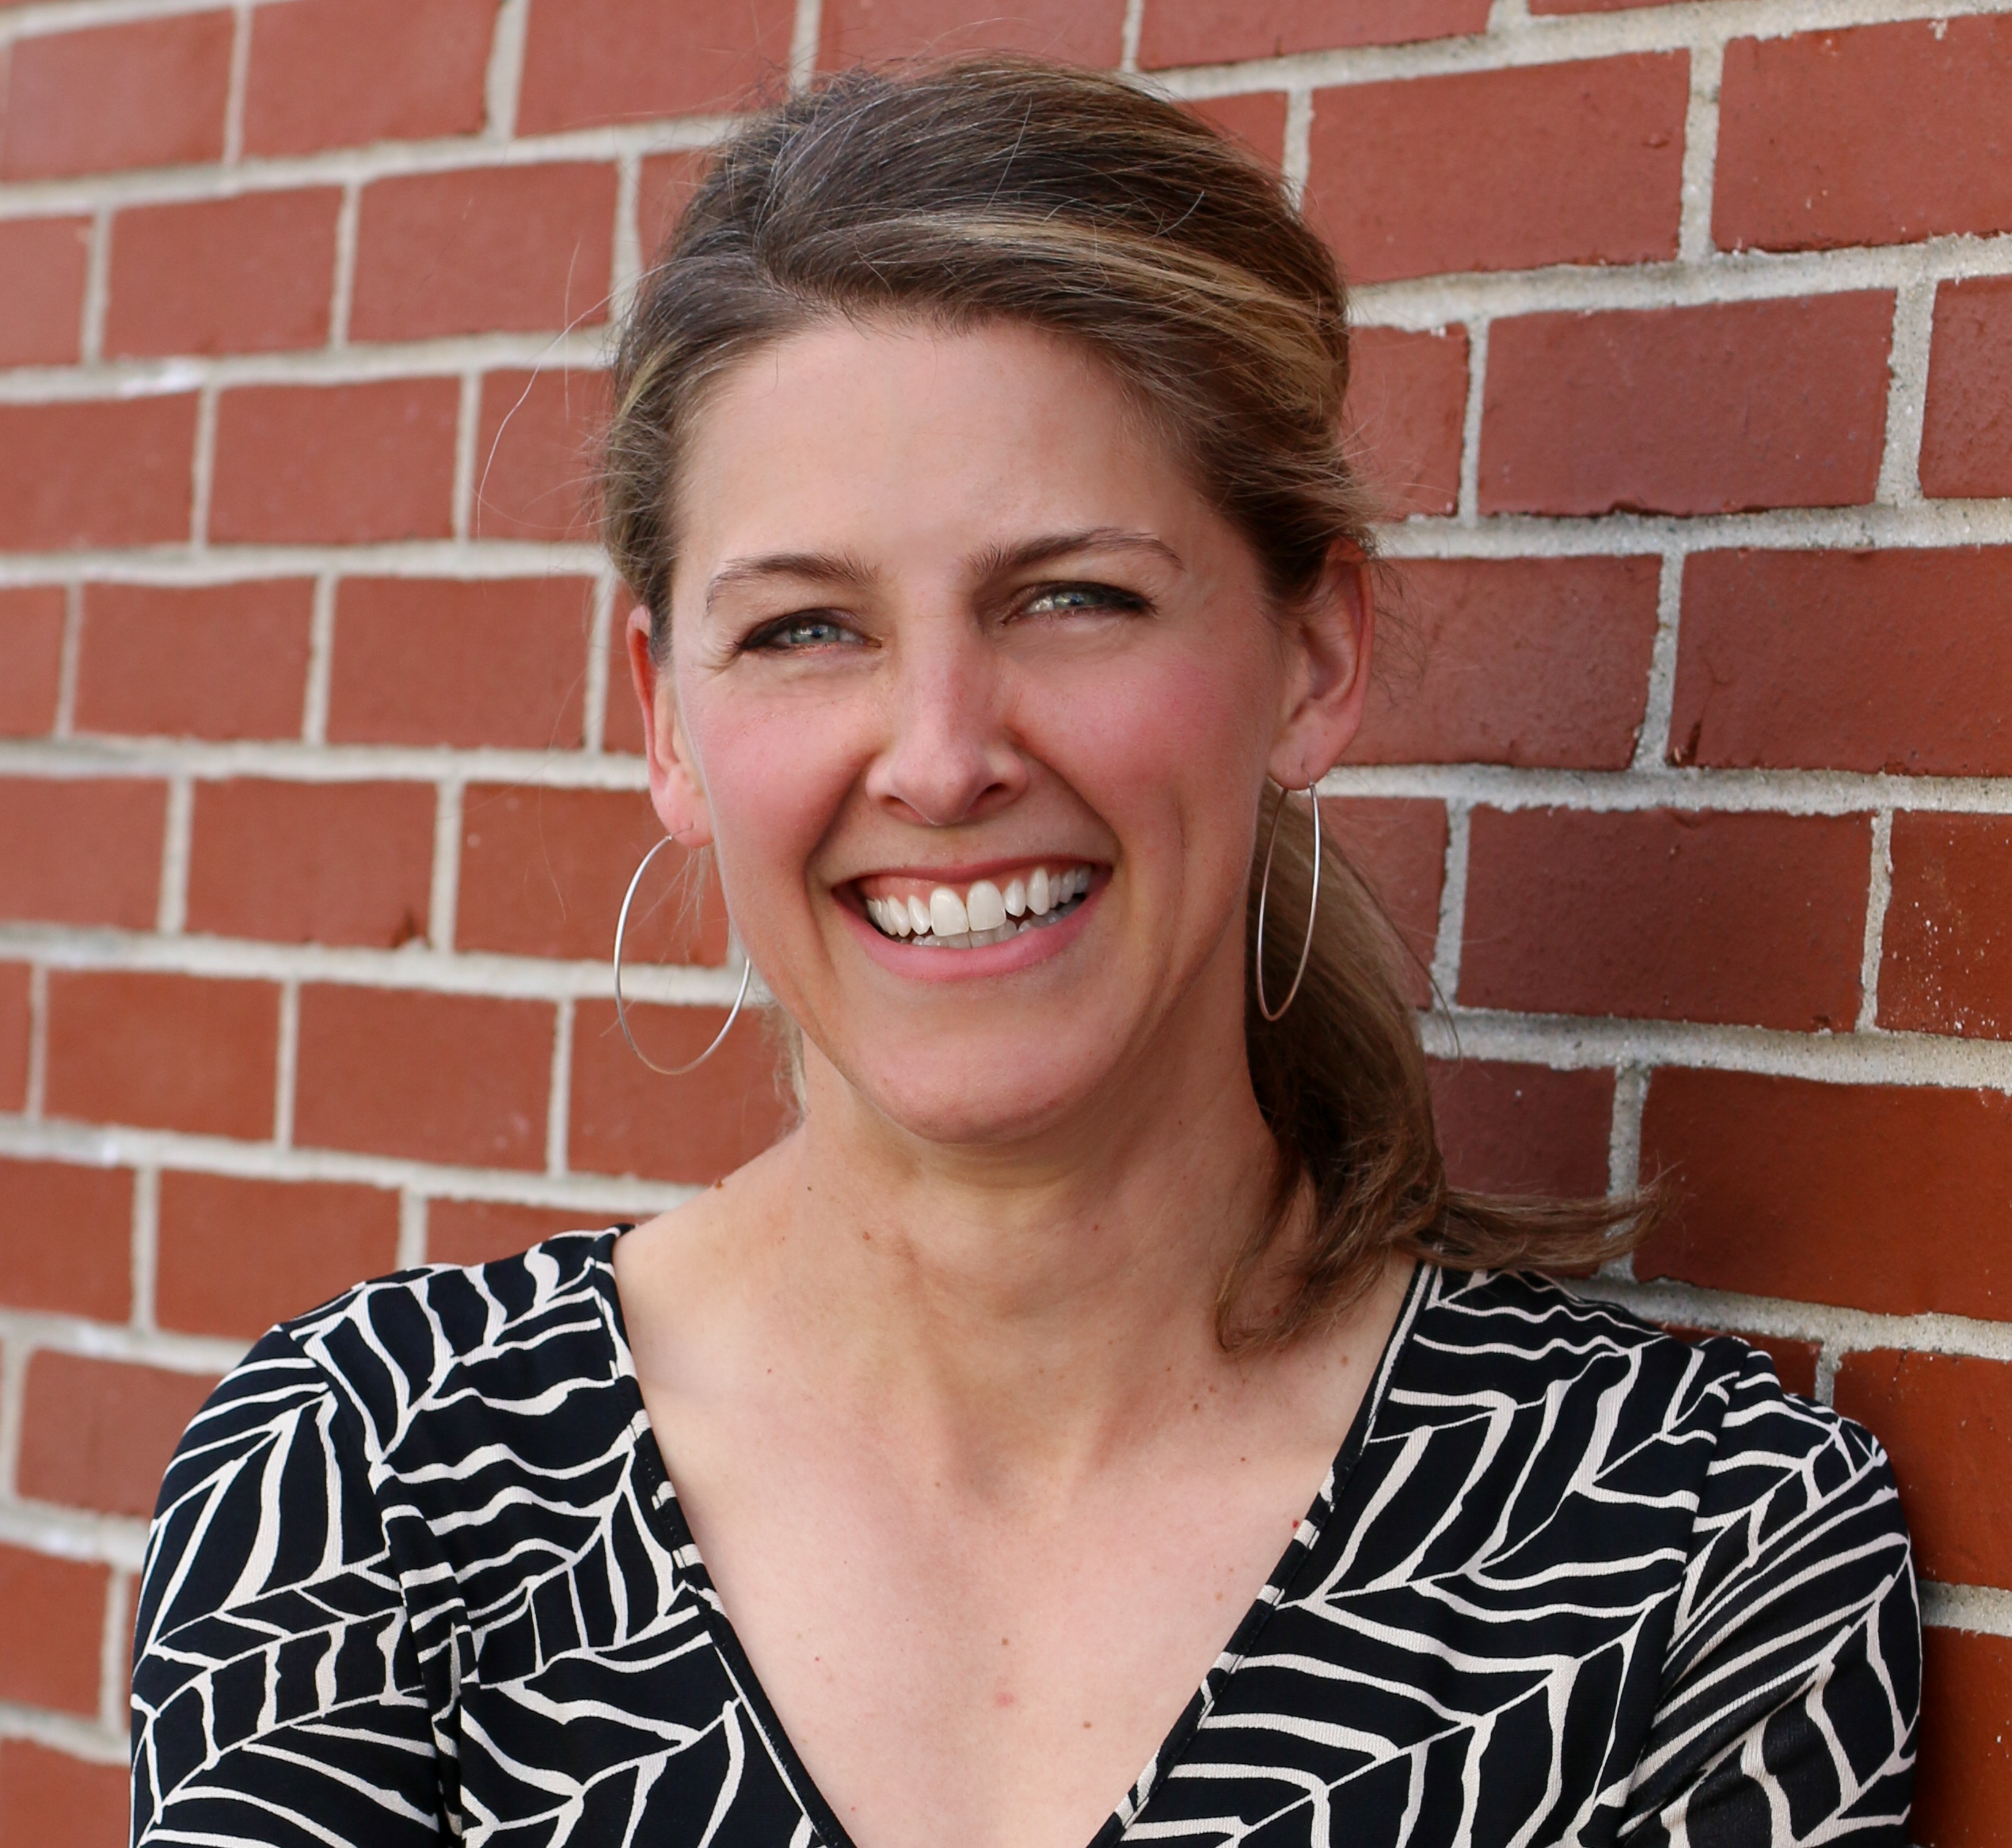
Our Team
Stacy Donohue
SAN Program Manager
Emily Levi
SAN Project Coordinator
Dianne Hasselman
Deputy Director
Notes:
Stacy 336
Meet our project team – we look forward to work with each of you
Dianne will take the next few minutes introducing you to NRHI

Slide 5
Who is the Network for Regional Healthcare Improvement (NRHI)?
A national network of 40 regional health improvement collaboratives (RHICs).
RHICs are non-profit, multi-stakeholder organizations working in and collaborating across regions to achieve better care at lower cost.
RHICs work together through NRHI to accelerate and spread regional innovation across the US.
“We’re stronger and more effective together.”
Notes:
Dianne – 336-338

Slide 6
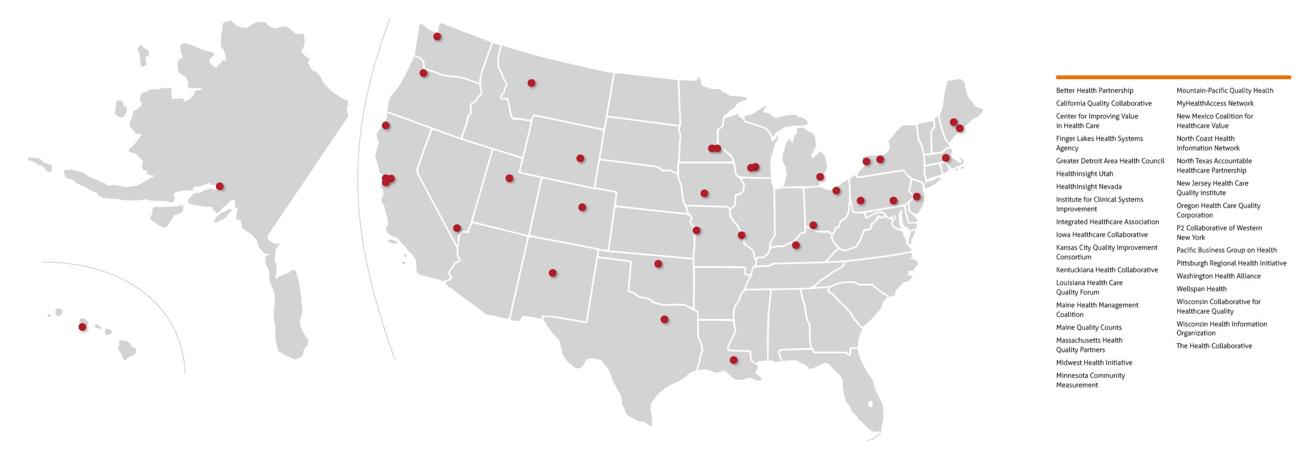
Better Health Partnership
California Quality Collaborative
Center for Improving Value in Health Care
Finger Lakes Health Systems Agency
Greater Detroit Area Health Council
Healthcare Collaborative
HealthInsight Utah
HealthInsight Nevada
HealthInsight New Mexico
Humboldt AF4Q
Institute for Clinical Systems Improvement
Integrated Healthcare Association
Iowa Healthcare Collaborative
Kansas City Quality Improvement Consortium
Kentuckiana Health Collaborative
Louisiana Health Care Quality Forum
Maine Health Management Coalition
Maine Quality Counts
Massachusetts Health Quality Partners
Michigan Center for Clinical Systems Improvement
Midwest Health Initiative
Minnesota Community Measurement
Mountain-Pacific Quality Health
MyHealthAccess Network
New Jersey Health Care Quality Institute
New Mexico Coalition for Healthcare Value
North Coast Health Information Network
North Texas Accountable Healthcare Partnership
New Jersey Health Care Quality Institute
Oregon Health Care Quality Corporation
P2 Collaborative of Western New York
Pacific Business Group on Health
Pittsburgh Regional Health Initiative
South Central PA
Washington Health Alliance
Wellspan Health
Wisconsin Collaborative for Healthcare Quality
Wisconsin Health Information Organization
The Health Collaborative
NRHI Members
Notes:
Dianne 339

Slide 7
About TCPI
Transforming Clinical Practice Initiative
September 2015, The Center for Medicare and Medicaid Innovation (CMMI) awarded $685 million to 39 (29 PTNs and 10 SANs) national and regional collaborative healthcare transformation networks and supporting organizations.
The TCPI is one of the largest federal investments uniquely designed to support clinician practices through nationwide, collaborative, and peer-based learning networks that facilitate practice transformation.
The TCPI model will assist clinicians in improving the way they deliver care by providing technical assistance support for integrating quality and process improvement, and by building on and spreading existing change methodologies, practice transformation tools, published literature, and technical assistance programs.
Notes:
Stacy 340
The NRHI High-Value Care SAN is in support of the overall Transforming Clinical Practice Initiative. We’re pleased to be in the company of 9 fellow SANs in support of the PTNs efforts to meet the TCPI aims.

Slide 8
TCPI Aims
Support more than 140,000 clinicians
Improve health outcomes for millions of patients
Reduce unnecessary hospitalization for 5 million patients
Generate $1 to $4 billion in savings
Sustain efficient care by reducing unnecessary tests and procedures
Build evidence base on transformation
Notes:
Hidden slide

Slide 9
Practice Transformation Networks
Arizona Health-e Connection
Baptist Health System, Inc.
Children's Hospital of Orange County
Colorado Department of Health Care Policy & Financing
Community Care of North Carolina, Inc.
Community Health Center Association of Connecticut, Inc.
Consortium for Southeastern Hypertension Control
Health Partners Delmarva, LLC
Iowa Healthcare Collaborative
Local Initiative Health Authority of Los Angeles County
Maine Quality Counts
Mayo Clinic
National Council for Behavioral Health
National Rural Accountable Care Consortium
New Jersey Innovation Institute
New Jersey Medical & Health Associates dba CarePoint Health
New York eHealth Collaborative
New York University School of Medicine
Pacific Business Group on Health
PeaceHealth Ketchikan Medical Center
Rhode Island Quality Institute
The Trustees of Indiana University
VHA/UHC Alliance Newco, Inc.
University of Massachusetts Medical School
University of Washington
Vanderbilt University Medical Center
Virginia Health Quality Center
VHS Valley Health Systems, LLC
Washington State Department of Health
Notes:
Stacy 342
Congratulations to the PTNs awarded

Slide 10
The TCPI SANs
American Board of Family Medicine | Developing MOC/CME modules, PRIME registry for quality reporting; collaborating with American College of Physicians.
American College of Emergency Physicians | Focusing on patient access, early identification, and healthcare utilization.
American College of Physicians | Healthcare utilization, advanced care, preventive care, patient and family engagement, and patient access. Collaborating with American Board of Family Medicine.
American College of Radiology | Radiology Support, Communication, and Alignment Network (R-SCAN): Quality Reporting, total cost of care, and reducing unnecessary tests and procedures.
American Medical Association | Engaging national physician community through network projects, training modules and story sharing. Areas include clinical data registries.
American Psychiatric Association | Training and implementation of evidence-based, population-focused integrated behavioral health programs.
Notes:
Stacy 343
And also to the SANs that we look forward to partnering with

Slide 11
The TCPI SANs
HCD International, Inc. | Areas of focus include minority health (medically underserved, rural and urban areas from across the nation) and healthcare utilization.
National Nursing Centers Consortium | Implementing a network to align nurses. Areas of focus include minority health, reaching underserved and other vulnerable populations.
HIGH-VALUE CARE SAN Network for Regional Healthcare Improvement | Spread transformation knowledge through high-value care learning program including focused on total cost of care, patient & family engagement, utilization, shared decision making, care management transitions, quality improvement including application to CME/MOC.
Patient Centered Primary Care Collaborative | The PaCCESAN will provide technical assistance to participating practices and networks across the US in order to promote deeper patient relationships and community engagement among care teams.
Notes:
Stacy 343

Slide 12
NRHI’s High-Value Care SAN
OVERVIEW
NRHI’s multi-faceted high-value care learning program will:
  Increase awareness around total cost of care and high-value care
  Provide evidence-based curricula, tools and training materials
  Incorporate learning program components into ABMS CME and MOC programs
  Be driven by user needs
To be delivered in various mediums:
    Videoconference
    Shared on-line platform
    In person
    One-on-one coaching
Notes:
Stacy 344
Learning program focused on total cost of care and high-value care
You’ll next hear from our partners on specific topic areas
We aim to align components of the learning program into CME/maintenance of certification requirements
The Learning Programs intend to be flexible to meet users needs – your input on specific needs is critically important to us

Slide 13
NRHI’s High-Value Care SAN
NRHI will leverage national partners and RHICs to advance TCPI goals of transformation to support and align PTNs and clinical networks:
  Leverage NRHI network to communicate / amplify TCPI strategies and learnings
Support PTNs with provider recruitment through communication campaign via NRHI network
Leverage expertise in performance measurement and payment reform
Align public / private partnerships around TCPI strategies
Leverage national partners (e.g., RWJF, ABIM, SIM, etc.)
Strategies
Notes:
Stacy 345
Hidden slide

Slide 14
NRHI’s High-Value Care SAN
MEASURES OF SUCCESS
Specific commitments to improve quality and reducing cost by…
  Decreasing readmissions
  Reducing unnecessary imaging studies for low back pain
  Decreasing ED utilization for ambulatory care sensitive conditions
Supporting PTNs by…
  Aiding clinician recruitment
  Driving engagement
  Providing education
  Sharing regional updates
  Disseminating best practices
Notes:
Stacy 346
Specific outcome commitments to CMS include these measures

Slide 15

NRHI’s High-Value Care SAN
LEARNING PROGRAM– sampling of topics
NRHI High – Value SAN Learning Program
Using total cost of care measurement
Implementing Choosing Wisely; Shared Decision Making
Patient engagement; Patient safety
Care management and transitions; population management
Difficult conversations
Integration of behavioral health in primary care
Notes:
Stacy 346
Graphic of learning program topics represents a sampling of programs and is not comprehensive

Slide 16
NRHI High-Value Care SAN Areas of Specialty (SAMPLING) | Total Cost of Care | Patient Engagement / Experience | Shared Decision Making / Utilization | QI Programming / Population Management | Difficult Conversations | Behavioral Health Integration
Better Health Partnership (Northeast Ohio) |  |  |  | Population Management; Useof registries; QI MOC
Massachusetts Health Quality Partners |  | Training to interpret patient experience results | Clinician engagement in practice pattern variation |  | Establishing patient/family council
Minnesota Community Measurement | Understanding, measuring and uses of TCoC measurement | Why cost, quality, experience transparency matters |  |  |  | Measuring and Reporting Depression Screening
Institute for Clinical Systems Improvement | Engaging physicians in improving total cost of care |  | Motivational Interviewing | QI Program Design | Discussing cost of care and appropriate care w/ clinicians | Integrating BH in primary care
Maine Quality Counts |  | Creating consumer engagement | Choosing Wisely | QI Program Design
Pittsburgh Regional Health Initiative |  | Patient Safety |  |  | End of life, palliative care; care transitions | BH skill building in primary care his
Oregon HealthCare Quality Corp. | Implementing TCoC reporting in alignment with payment reform |  |  | Building QI infrastructure; Medical home implementation
Notes:
Stacy 347
The NRHI SAN clinical and quality improvement faculty have expertise in several high-value care topics. In many cases expertise is shared across multiple organizations.
For example – the total of care learning program offers best practices from three organizations:
Today you’ll hear from Tony at Minnesota Community Measurement about how to measure total cost of care and Jan from ICSI on how to engage clinicians in total cost of care improvement. Additionally, Oregon HealthCare Quality Corporation (Q-Corp) has expertise in implementing and aligning TCOC measurement.

Slide 17


NRHI’s High-Value Care SAN
CLINICAL & QUALITY IMPROVEMENT FACULTY EXPERTS
Better Health Partnership (Northeast Ohio)
Practice Transformation, Population Management
QI methodology, innovation and reporting – application to CME/MOC
Hypertension best practice
Oregon Health Care Quality Corporation
Patient centered medical home focus on building QI infrastructure
Team-based care, leadership/culture
Implementing total cost of care reporting
Notes:
Stacy 348

Slide 18


NRHI’s High-Value Care SAN
CLINICAL & QUALITY IMPROVEMENT FACULTY EXPERTS
Institute for Clinical Systems Improvement (MN)
Engaging physician in improving total cost of care
Behavioral health integration and improvement
Minnesota Community Measurement
Understanding, measuring and uses of total cost of care measurement
Measuring and Reporting Depression Screening
Notes:
Stacy 349

Slide 19



NRHI’s High-Value Care SAN
CLINICAL & QUALITY IMPROVEMENT FACULTY EXPERTS
Pittsburgh Regional Health Initiative Care
management and transitions particularly from hospital discharges; difficult conversations
Maine Quality Counts
Choosing Wisely and reducing inappropriate utilization; QI practice transformation; creating consumer engagement
Massachusetts Health Quality Partners Patient engagement; helping physicians interpret patient experience survey results
Notes:
Stacy 350
To keep us moving along, I’ll now turn it over to Jan from ICSI to tell you about who they are and the expertise available

Slide 20
Institute for Clinical Systems Improvement (ICSI)
Janet Schuerman, Senior Director
  Independent, non-profit organization
  Formed in 1993 by Mayo Clinic, HealthPartners, and Park Nicollet
  Collaboration of 50+ medical group and hospital members representing approximately 9,000 physicians
  Supported by three non-profit MN health plans
  The region's leading health care collaborative
The mission of our collaboration is to champion the cause of health care quality and to accelerate improvement in the value of the health care we deliver.
Our vision is to be a collaboration that is deemed essential by its members for their improvement of health care and deemed essential by our community as a trusted voice for quality in health care.

Slide 21
Potential ICSI Offerings
Quality Improvement – basics and beyond
Motivational Interviewing and Shared Decision Making Skill Building
Using total cost of care and other data to focus improvement efforts
Mental Health Integration and Improvement

Slide 22
Quality Improvement – basics and beyond
Learn basic structural, process and cultural strategies to achieve systematic & continuous measurable improvement:
Practical basics include:
  Plan-Do-Study-Act cycle
  Developing aims and measures
  Team development
  Adaptive and technical leadership needed to create change and improve practices.

Slide 23
Motivational Interviewing (MI) &
Shared Decision Making (SDM)
Skill Building
Gain understanding of MI/SDM concepts, goals and applications
Identify strategies to listen for, elicit and promote change talk
Planning and building clinical team skills in MI/SDM to support patient motivation for change and decision-making.
Extended program offers practice using real life situations and common encounters

Slide 24
Here’s Data. Now What?
Use total cost of care and other data to focus improvement efforts
Practical learning and strategy to understand:
  Why is the data important?
  What impact does it have?
  How do I use it?
  How can we change it?

Slide 25
Mental Health Integration and Improvement
Gain understanding of successful models and strategies to:
Improve depression screening and outcomes
Support mental health patient in primary care
Improve care transitions from in-patient care
Influence determinants outside the clinical walls
Notes:
Thank you Jan.
Next up, Tony Weldon from MNCM

Slide 26
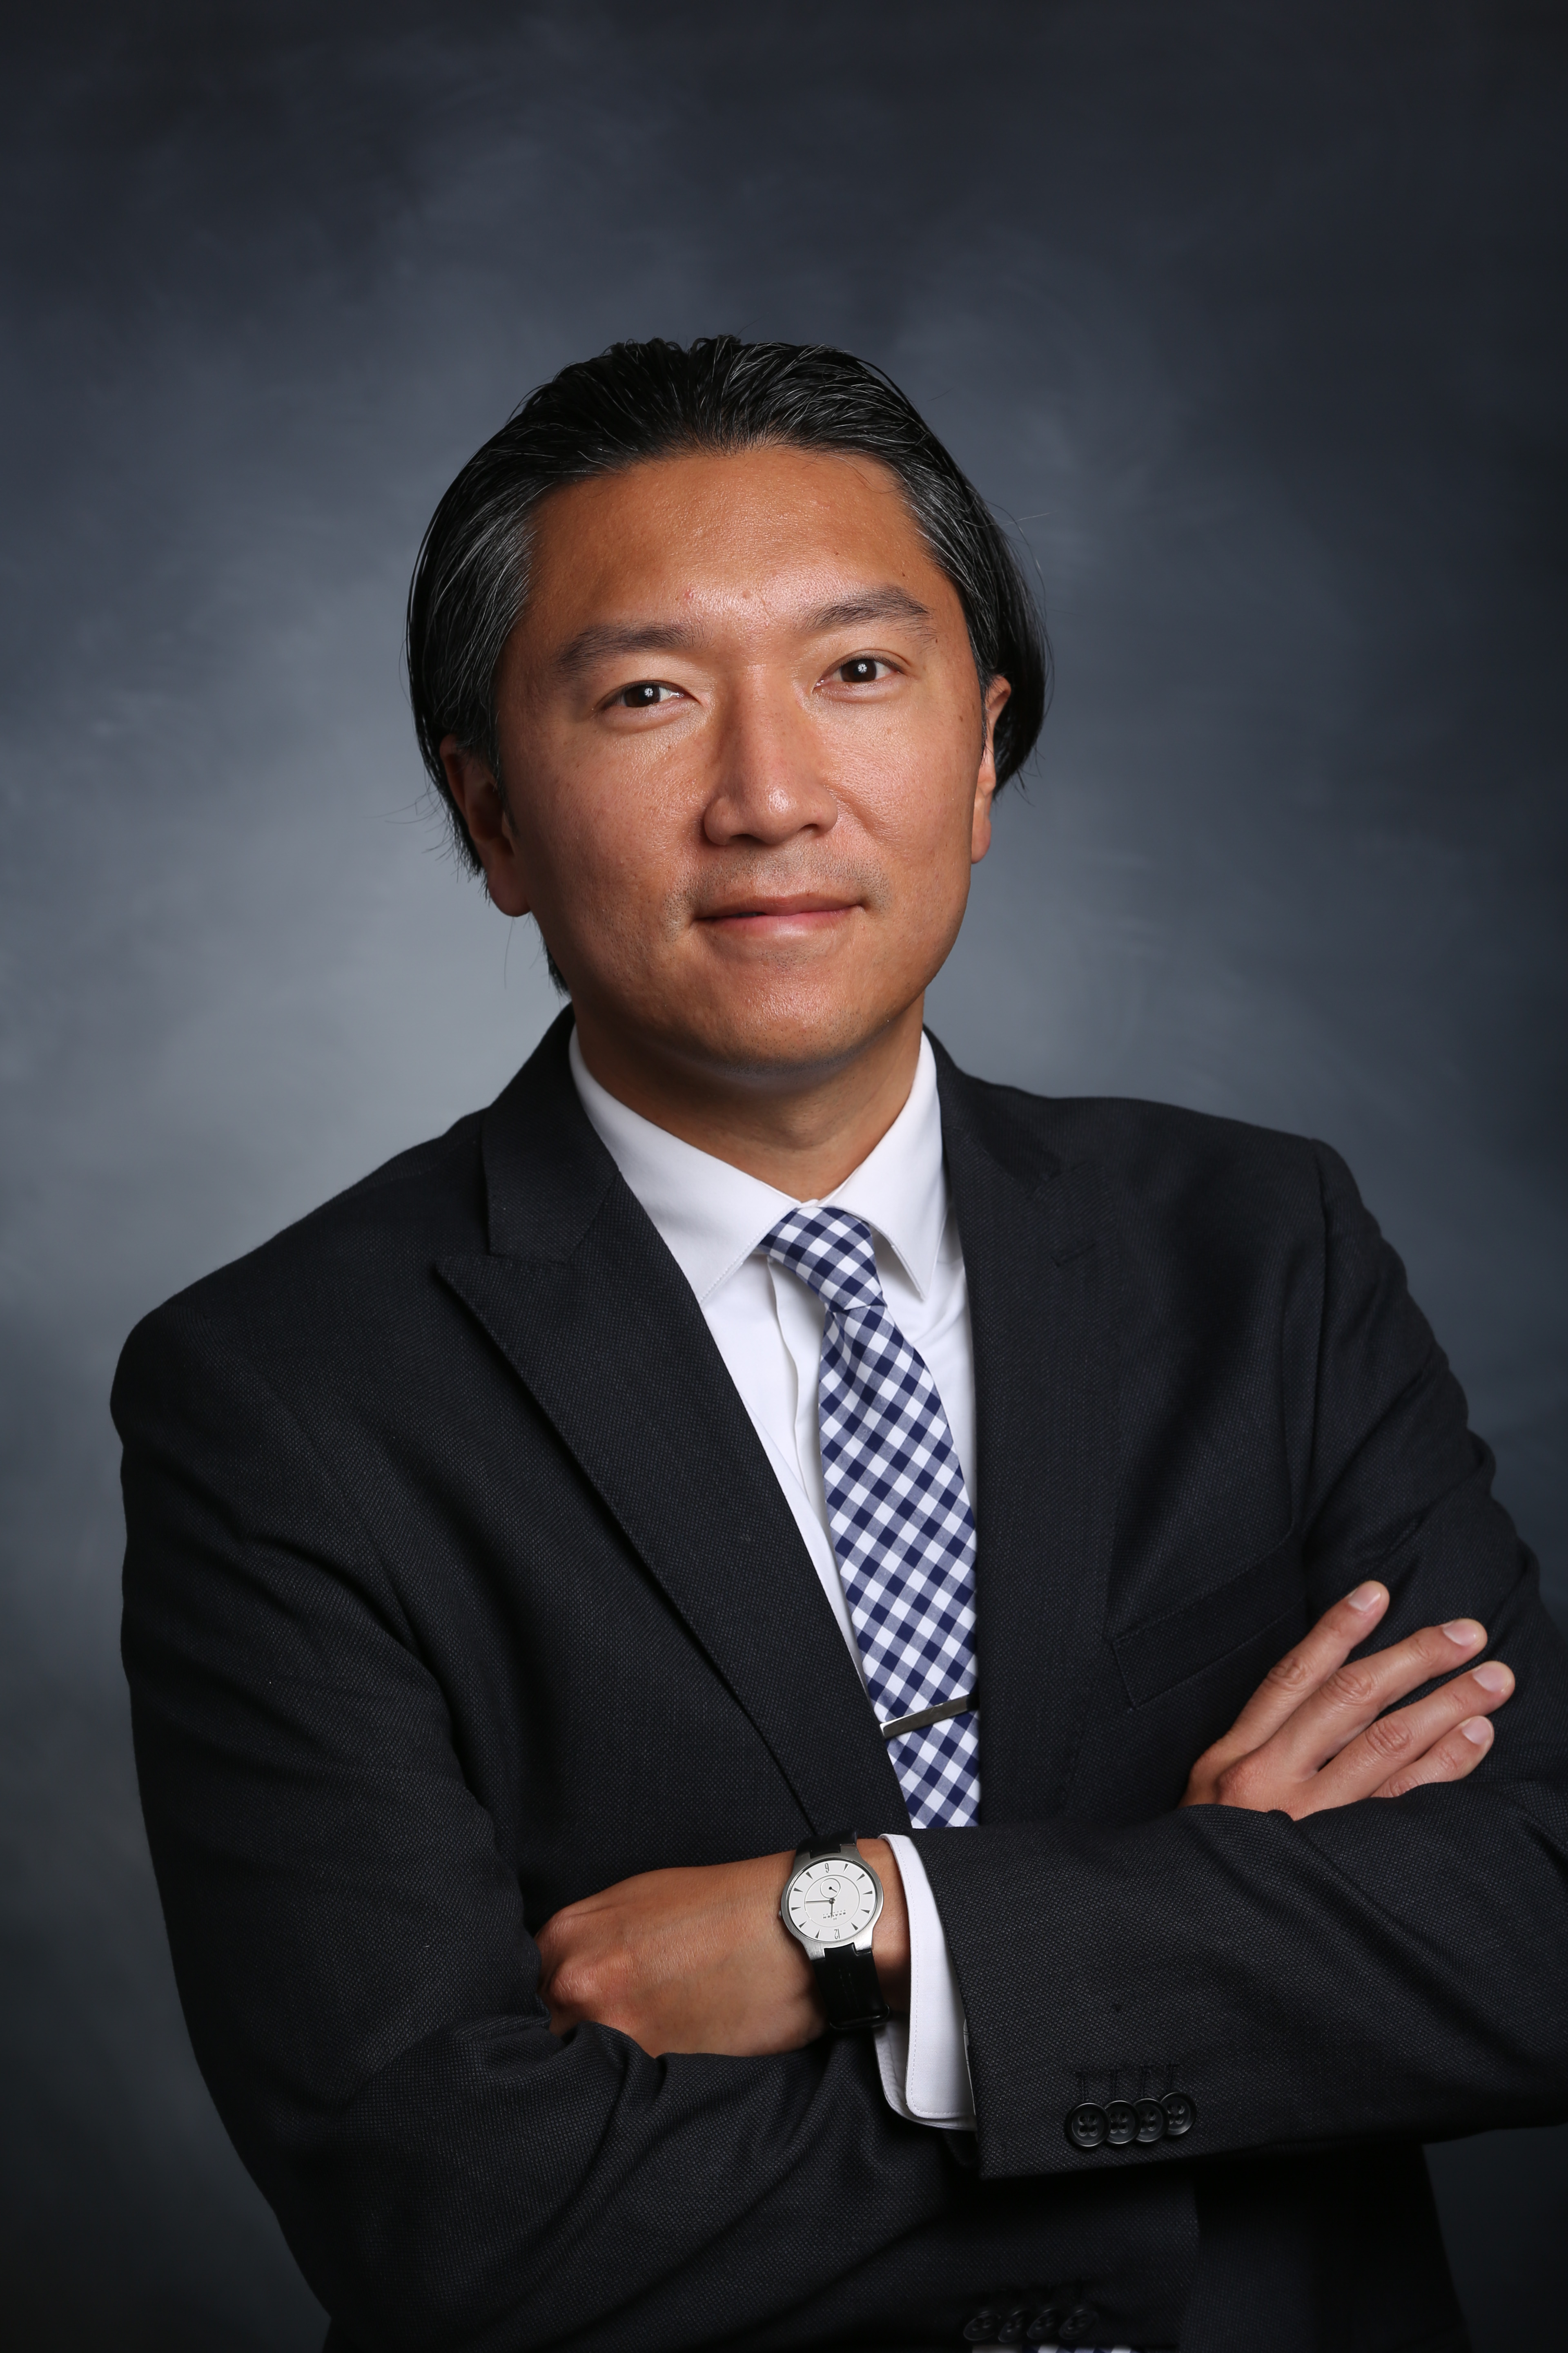
MN Community
Measurement
Tony Weldon, Project Manager &
Data Analyst
Analyst
MN Community Measurement is a 501c3 non profit organization
dedicated to accelerating improvement in Health Care by Publicly
reporting Health Care Information
Our vision:
  To be the primary trusted source for health data sharing and measurement
  To drive change that improves health, patient experience, cost and equity of care for everyone in our community
  To be a resource used by providers and patients to improve care
  To partner with others to use our information to catalyze significant improvements in health

Slide 27
Measurement & Reporting
Quality Process measures since 2003
Quality & Patient Reported Outcome measures since 2008
Patient Experience measures since 2013
2009 Publicly reported Average Cost per Procedure measure for most prominent procedures; Commercial
2014 Publish Total Cost of Care measure; Commercial
2015 Publicly reported Total Cost of Care; second year in a row
  Publicly reported Average Cost per Procedure for a third time
  Added Medicare and Medicare FFS rates to Cost Per Procedure
2016: Piloting for Planned Reporting: Relative Resource Use; Commercial
  Medicaid Total Cost of Care and Resource Use
  Medicare Total Cost of Care and Resource Use
  Episodes of Care
Quality
Cost Suite
Future Considerations

Slide 28
Total Cost of Care Results
Two Year Comparison | 2014 | 2015
Total number of qualifying Medical Groups | 116 | 132
Total patients | 1.5M | 1.5M
Total dollars | $8.1B | $8.4B
Cost per patient per month | $435 | $449
Adult cost per patient per month | $513 | $529
Pediatric cost per patient per month | $216 | $225
Statewide distributed model using four major health plans in the MSP area – No APCD
Stability Testing
  Measure Correlation Coefficient TCI for same groups for two years
  Medical Group unit of measure – reliability and repeatability

Slide 29

NRHI High – Value Care SAN Offering: Total Cost of Care Measurement and Reporting
Content outline:
  What it is
  Why it matters
  How it is done
  Pros and Cons of Various Data Sources
  Reporting to the Public, Providers & Health plans to catalyze movement
  Marketplace uses for the information
Notes:
Thank you Tony.
Now we’ll hear from Nancy and Bruce at PRHI.

Slide 30

Nancy Zionts, Chief Program and Operating Officer
Bruce Block, MD, Chief Learning and Medical Informatics Officer
Pittsburgh Regional Health Initiative’s
Evolving Agenda
One of the first regional health improvement collaboratives (RHIC) established in 1997 by Karen Wolk Feinstein and then-ALCOA Chairman Paul O’Neill
We brought Lean to Health Care!
MAKING HOSPITALS SAFER
KEEPING PEOPLE OUT OF HOSPITALS
IMPROVING THE CAPACITY OF PRIMARY CARE TEAMS
SUPPORTING AN ACTIVATED PATIENT-PROVIDER RELATIONSHIP
MAKING
HOSPITALS
SAFER
Notes:
We build what we do on data analyses and try to address "flaws" in the system. We have moved from bringing safety, reliability and efficiency to hospitals to keeping people out of hospitals: transforming primary care, improving clinical care in SNFs, keeping people out of SNFs, looking for new models of primary care. We have advanced our research capability, ability of PCPs to use IT for QI, our longstanding leadership in educating/training/coaching HC workers in QI. In this newest era of big data and open health information, we have taken on the task of helping to create empowered healthcare consumers and helping to create good physician partners

Slide 31
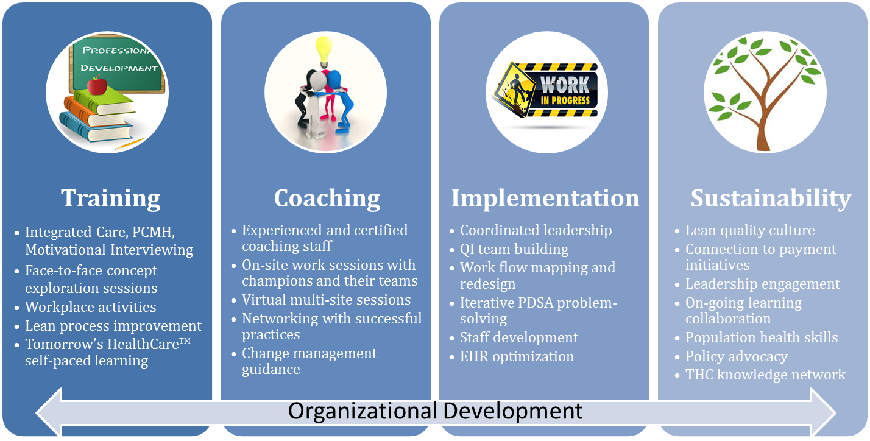
PRHI’s Care Transformation Approach

Slide 32
Pittsburgh Regional Health Initiative
Programming available in support of the High – Value Care SAN:
  Patient safety and quality training: Introduction to Lean; Leading a Lean Organization; Identifying Concerns; Assessing Work Processes; Analyzing Causes; Designing Countermeasures; Implementing Change; Using Evidence to Inform Iterative Change; Sustaining and Spreading Change
  Care Transformation: Leadership Engagement; Quality Improvement Strategy; Population Health; Team-Based Care; EHR and Evidence-Based Care; Patient-Directed Care; Care Coordination; Training for Providers, Practice Managers, Care Managers, and Clinical Assistants in Behavioral Health Integration, and Management of Care Transitions.

Slide 33
Pittsburgh Regional Health Initiative
Programming available in support of the High – Value Care SAN: Difficult Conversations
  Advance Care Planning (especially in light of new Medicare codes)
    A range of tools and curriculum to train front line staff (primary care, long term care, acute care), patients and caregivers
    About how to have and document goals of care conversations including but not limited to FIVE WISHES, Living Wills, Healthcare Surrogates
      Focus on a range of diagnoses (beyond oncology, chronic disease, Alzheimer’s etc.
    POLST (Physician Orders for Life Sustaining Conversations
  Collaborative Conversations: Motivational Interviewing (intro, intermediate, advanced); Behavioral Activation; Organizational Communication; Health Literacy and Patient-Directed Care; Train-the-Trainer

Slide 34
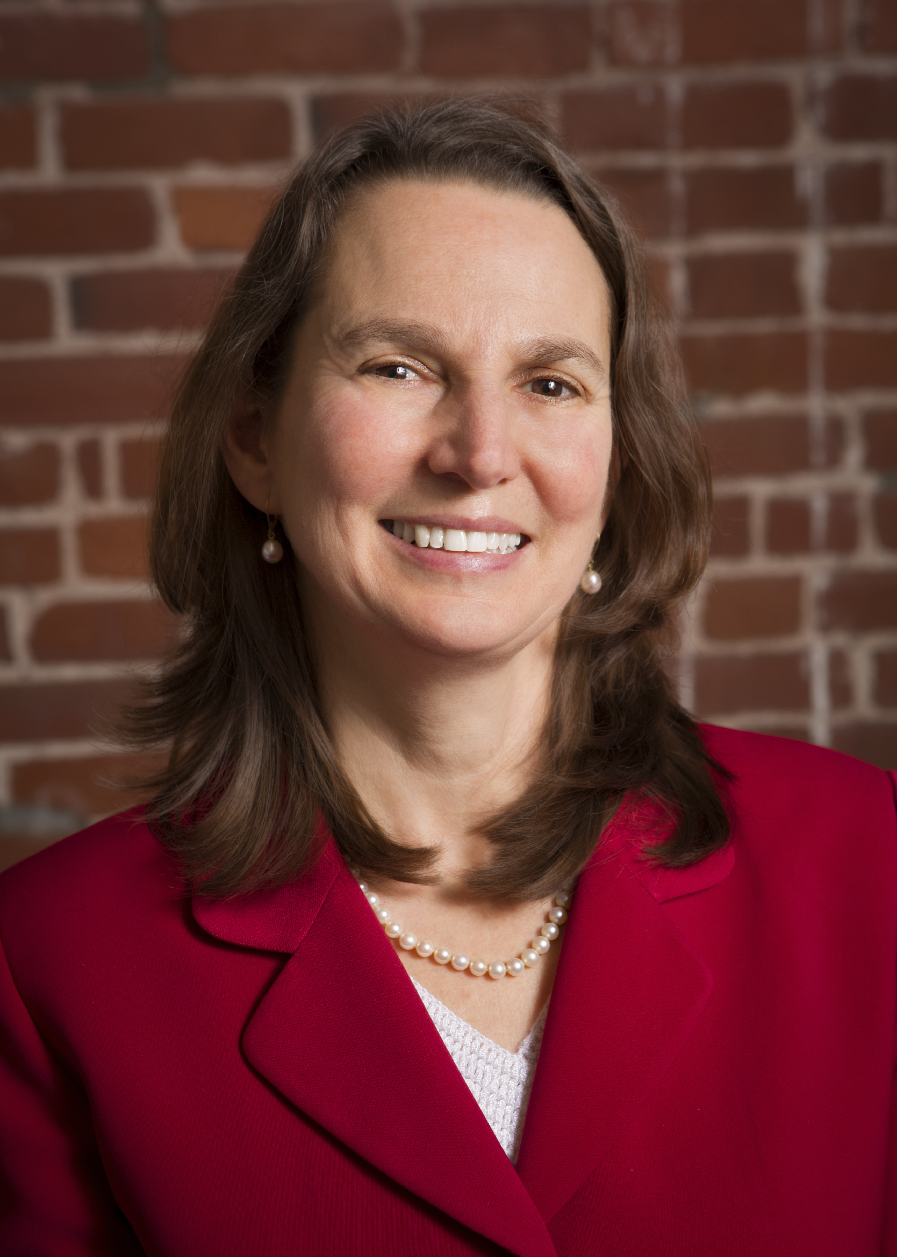
Massachusetts Health Quality Partners
Barbra Rabson, President and CEO
Established in 1995, MHQP is a non-profit regional health improvement collaborative comprised of physicians, hospitals, health plans, purchasers, patients, academics and government agencies working together to improve the quality and value of MA health care.
MHQP’s mission is to drive measurable improvements in health care quality, patients’ experiences of care, and use of resources in Massachusetts through patient and public engagement and broad-based collaboration among health care stakeholders.
Notes:
Thank you Nancy and Bruce.
Next up, Barbra Rabson from Massachusetts Health Quality Partners

Slide 35
MHQP’s Approach
MHQP Change Model:
Drive change within the healthcare system with a dual approach that engages both clinicians and leaders in the healthcare systems, as well as patients and their families.

Slide 36
Potential MHQP Program Offerings
Patient Engagement: Guidance for establishing a patient/family council
Integrating the Patient Experience in Care Improvements: Helping physicians interpret their patience experience survey (PES) results
Provider Engagement in Appropriate Care: Establishing a Practice Pattern Variation Analysis Program

Slide 37
Patient Engagement: Guidance for establishing a patient/family council
Gain an understanding of successful strategies and critical steps to:
Establish a patient engagement strategy
Develop recommendations for Council structure and composition
Set goals, value statement and charge for a consumer council
Develop a recruitment strategy to create an effective council
Provide effective training to council members

Slide 38
  Patient Experience: Integrating the Patient Experience in Care Improvements
Strategies and critical steps to further understanding and improvement of patient experience:
  Advise organizations on options for systematically capturing patient experience
  Design structured meetings with provider organizations to discuss their own results; what do they mean; what the science is behind the results; and how to talk with their own providers about areas of improvement
  Share resources to drive improvements in specific areas of patient experience

Slide 39
  Provider Engagement in Appropriate Care: Establishing a Practice Pattern Variation Analysis (PPVA) Program
Develop an understanding of the importance and the critical analytic elements of a PPVA program
Learn how to create a safe environment (e.g. through the setting of ground rules, appropriate language and data use agreements) to engage multiple organizations and providers in the analysis of practice pattern variation
Learn how to create a successful program to share results with providers and begin non-judgmental conversations about the reasons for the variation that is observed
Notes:
Thank you Barbra.
Last up, Lisa Letourneau from Maine Quality Counts to provide an overview her organization and its work with the Choosing Wisely programs.

Slide 40
A regional healthcare collaborative where the people who get, provide and pay for health care come together to improve health care quality and affordability throughout Maine.
Maine Quality Counts
Lisa Letourneau, MD, MPH, Executive Director
OUR MISSION
Maine Quality Counts is transforming health and health care in Maine by leading, collaborating and aligning improvement efforts
OUR VISION
Through the active engagement and alignment of people, communities and health care partners, every person in Maine will enjoy the best of health and have access to patient centered care that is uniformly high quality, equitable and efficient
Notes:
The Choosing Wisely® campaign brings several passionate groups together to help physicians, patients and other health care stakeholders talk about the overuse of health care resources in the U.S. More than thirty national organizations representing medical specialists, as well as Consumer Reports and a number of consumer-focused organizations, are working with the ABIM Foundation to create a set of recommendations for physicians and patients to talk about together.
The goal of Choosing Wisely is to encourage conversations between physicians and patients about the overuse of tests and procedures and support physician efforts to help patients make smart and effective care choices.
Physicians and patients need to work together to make wise decisions about treatment. This means helping patients learn about care that is proven to be successful, safe and truly necessary for them.

Slide 41

Implementing Choosing Wisely
Maine Quality Counts provides expertise designing & leading Choosing Wisely campaigns
-Creating consumer engagement
-Supporting physician efforts to help patients make smart and effective care choices
Choosing Wisely® is initiative of ABIM Foundation
Intended to help physicians and patients engage in conversations about overuse of tests and procedures
Supports physician efforts to help patients make smart and effective care choices
Notes:
The Choosing Wisely® campaign brings several passionate groups together to help physicians, patients and other health care stakeholders talk about the overuse of health care resources in the U.S. More than thirty national organizations representing medical specialists, as well as Consumer Reports and a number of consumer-focused organizations, are working with the ABIM Foundation to create a set of recommendations for physicians and patients to talk about together.
The goal of Choosing Wisely is to encourage conversations between physicians and patients about the overuse of tests and procedures and support physician efforts to help patients make smart and effective care choices.
Physicians and patients need to work together to make wise decisions about treatment. This means helping patients learn about care that is proven to be successful, safe and truly necessary for them.

Slide 42
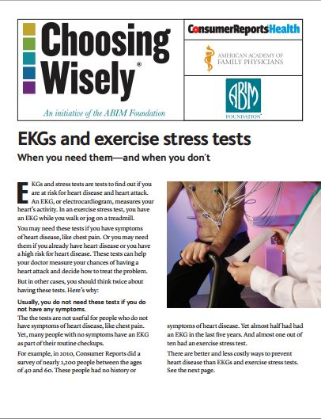
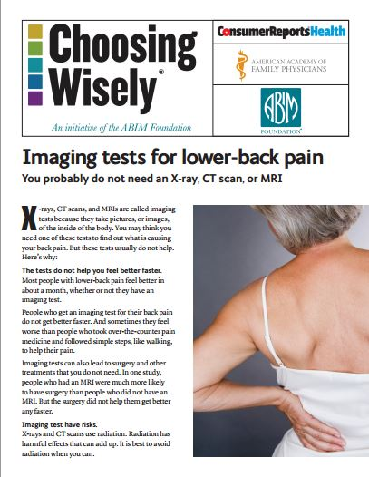
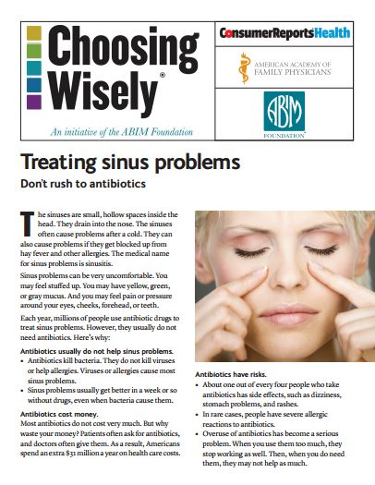
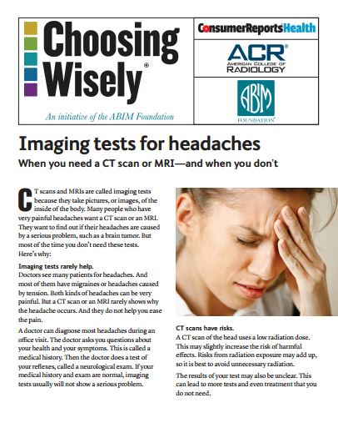
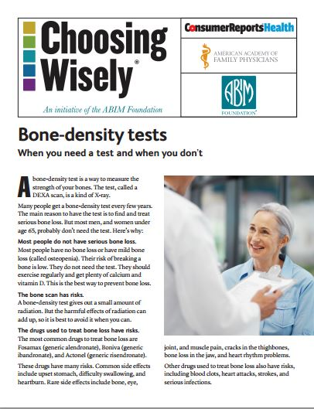
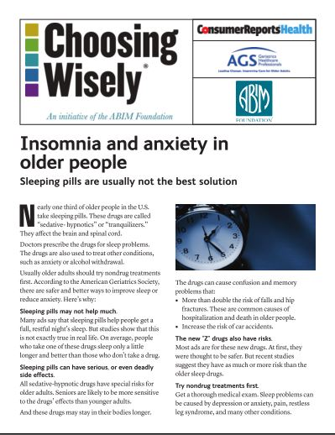

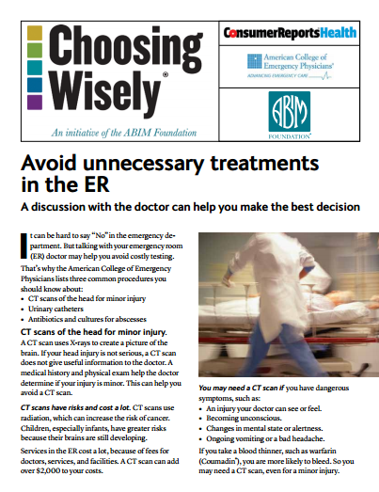
Choosing Wisely: Consumer Reports Fact Sheets
Notes:
Thank you Lisa.
We’re ready to wrap up

Slide 43

NRHI’s High-Value Care SAN
Thank you for joining us today!
To learn more about the High-Value Care SAN please contact the NRHI Team directly:
Stacy Donohue sdonohue@nrhi.org
Emily Levi elevi@nrhi.org
Join the NRHI High-Value SAN HealthCare Community:
www.healthcarecommunities.org
Please complete the feedback survey: Following this event, you will receive an email communication from NRHI Communications with a link to brief survey and a copy of these slides
HOW TO GET INVOLVED AND LEARN MORE
Notes:
Thank you to our presenters and our audience for joining us today.
We hope that this overview has been helpful and opens the door to working with each of you in support of TCPI.
This slide deck will be included with the feedback survey and also posted on healthcare communities.org in the NRHI High – Value SAN Community

